Slide 1
Unit 2: Implementation
© Copyright IBM Corporation 2015
Notes:
© Copyright IBM Corporation 2015

Slide 2
Unit objectives
Explain the Sterling File Gateway dynamic route.
Discuss the Sterling File Gateway file layers.
Generate Sterling File Gateway reports.
Explain the extensibility of Sterling File Gateway.
© Copyright IBM Corporation 2015
Notes:
© Copyright IBM Corporation 2012

Slide 3
Lesson 1
Dynamic Route
© Copyright IBM Corporation 2015
Notes:
© Copyright IBM Corporation 2012

Slide 4
Lesson objectives
Describe the major functionality of dynamic routing channel.
Configure a dynamic routing channel template.
Apply business process to determine consumers.
Explain and configure broadcast messages using dynamic routing channel template.
Explain mass replay and redeliver of processed transaction.
© Copyright IBM Corporation 2015
Notes:
© Copyright IBM Corporation 2015

Slide 5
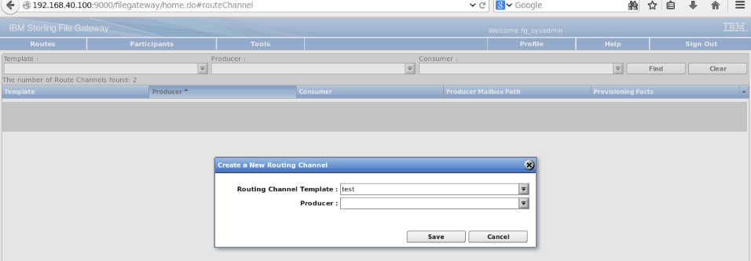
Routing Channels
Routing channels match incoming producer files to the appropriate consumer and then transform the file and file name according to the policies of the consumer.
Route Provisioners create routing channels. Before routing channels can be created, the Integration Architect should create a routing channel template and the Route Provisioner should create the producer and consumer Partners.
For a dynamic routing channel, no consumer is explicitly specified.

Slide 6
Business process decides consumer
The consumer identification policy is the method Sterling File Gateway uses to identify the consumer to receive the file transfer.
The consumer identification policy is defined in the routing channel template.
To implement a specific policy:
Write a business process to implement the consumer identification policy. For example, your business process can contain a map to derive the consumer name. Note the element name in ProcessData that contains the consumer name.
When you create a routing channel template, select Dynamic for Template Type.
Under What will determine the consumer?, select Business Process.
Specify the business process name.
Specify the element name in ProcessData that contains the consumer name
© Copyright IBM Corporation 2015

Slide 7
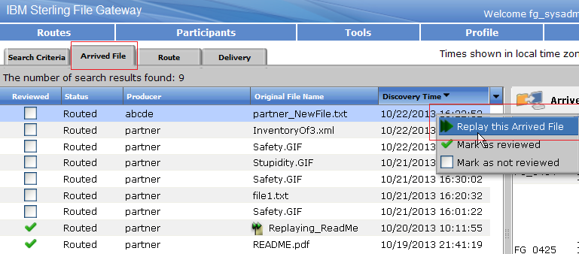
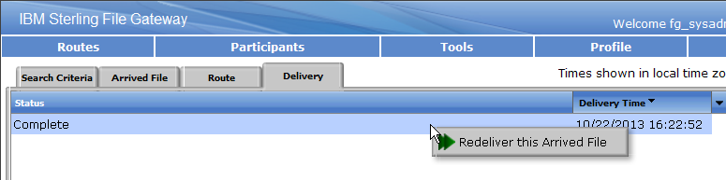
Replay and ReDeliver

Slide 8
Broadcasting
You can create dynamic routing channel templates to route copies of the same file to multiple consumers.
The set of consumers receiving a copy of the payload file can be defined either through the system fact ConsumerBroadcastGroup or through a business process that returns multiple consumer partner names.
You can configure multi-consumer broadcast message during Routing Channel Template, Routing Channel, and Shared Mailboxes.

Slide 9
Shared and linked mailboxes
Linking trading partner mailboxes to shared mailboxes allows trading partners to view real-time data that is stored in the shared mailboxes.
The linked mailbox has read-only copy of the shared mailbox and the trading partners cannot modify or delete data in it.
To enable the shared and linked mailbox feature in Sterling B2B Integrator, set the following property in the customer_overrides.properties file as:
mailbox.enableSharedLinkedMailboxes=true
By default, this property is set to false.
This property change adds an additional field Mailbox Type to the mailbox configuration page.
Sterling File Gateway creates new or reuses existing mailboxes as necessary to support producer drop of and consumer pickup of messages for a routing channel.
© Copyright IBM Corporation 2015

Slide 10

Exercise
Graphic must not be moved, added to, or altered in any way.
  Create dynamic outbound route.
  Build mailbox add business process.
  Create inbound dynamic route business process.
  Broadcast message through dynamic routing.
  Broadcast messages using shared mailboxes.
Notes:
Please see the exercise manual to start and enter the individual environments

Slide 11
Completed lesson objectives
Describe the major functionality of dynamic routing channel.
Configure a dynamic routing channel template.
Apply business process to determine consumers.
Explain and configure broadcast messages using dynamic routing channel template.
Explain mass replay and redeliver of processed transaction
© Copyright IBM Corporation 2015
Notes:
© Copyright IBM Corporation 2015

Slide 12

Questions
© Copyright IBM Corporation 2015
Notes:
© Copyright IBM Corporation 2015

Slide 13
Lesson 2
File Layers
© Copyright IBM Corporation 2015
Notes:
© Copyright IBM Corporation 2012

Slide 14
Lesson objectives
Explain the importance of file layers in Sterling File Gateway.
Discuss to add custom file layer in Sterling File Gateway.
Explain to extract compressed file layer.
Create a routing channel template and routing channel for layered file.
© Copyright IBM Corporation 2015
Notes:
© Copyright IBM Corporation 2015

Slide 15
Introduction
In Sterling File Gateway, File Layers are used to describe the layers or wrappings around the innermost file.
Sterling File Gateway uses the file layer description to transform the producer file into a format that meets the consumer’s business requirements.
This file brokering capability enables significant file transfer flexibility.
© Copyright IBM Corporation 2015

Slide 16
Introduction (Contd..)
Routing channel templates use file layer types to describe producer and consumer file structures.
The following file types are supported:
  Container Layer
  Non Container Layer
Sterling File Gateway uses the file layer descriptions to transform the producer file into a format that meets the consumer’s business requirements.
This file brokering capability enables significant file transfer flexibility. If the producer file does not fit the description in the routing channel template, the file is not routed

Slide 17
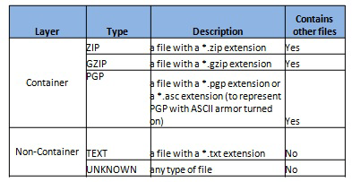
Container and non-container file layers
Container type layers : contain other container or non-container layers.
For example, a PGP layer can contain a ZIP layer and a ZIP layer can contain a TEXT layer. A zip file can only contain multiple files if it is the outermost layer. The standard container types are:
  ZIP
  GZIP
  PGP
Non-container type layers - or primitive, do not contain any nested layers. The standard non-container layers are:
  Text
  Unknown

Slide 18
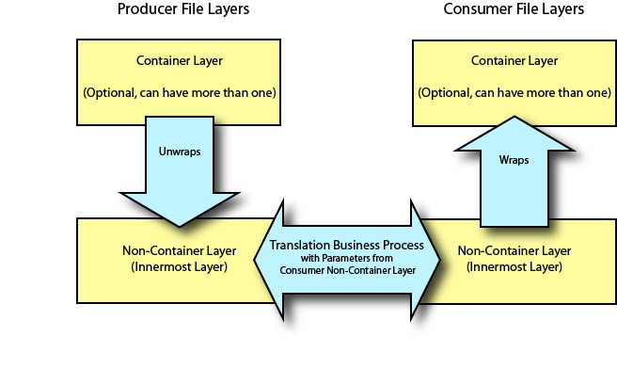
File layer communication

Slide 19
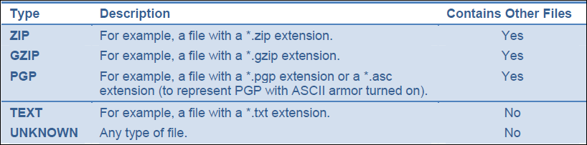

File layer description

Slide 20
Exercise
Graphic must not be moved, added to, or altered in any way.
  Unwrap an inbound compressed files into a text file.
Notes:
© Copyright IBM Corporation 2015

Slide 21
Completed lesson objectives
Explain the importance of file layers in Sterling File Gateway.
Discuss to add custom file layer in Sterling File Gateway.
Explain to extract compressed file layer.
Create a routing channel template and routing channel for layered file.
© Copyright IBM Corporation 2015
Notes:
© Copyright IBM Corporation 2015

Slide 22
Questions
© Copyright IBM Corporation 2015
Notes:
© Copyright IBM Corporation 2015

Slide 23
Lesson 3 Reports
© Copyright IBM Corporation 2015
Notes:
© Copyright IBM Corporation 2012

Slide 24
Lesson objectives
Explain about Sterling File Gateway reports.
Create reports for the processed transactions.
© Copyright IBM Corporation 2015
Notes:
© Copyright IBM Corporation 2015

Slide 25
Introduction
Reports are the document containing information organized in a required format.
Reports are created periodically, to know the status of the system during peak and non-peak transaction hours.
Review history of incoming and outgoing documents, and place the information on a chart showing daily, weekly, and monthly processing trends.
Report charts determines peak volume processing levels according to historical processing methods.
In addition to Sterling File Gateway report, review the other reports, such as the Database usage report, performance statistics report and the cache usage report, to determine processing levels.
© Copyright IBM Corporation 2015

Slide 26
Exercise
Graphic must not be moved, added to, or altered in any way.
  Generate report for the failed and successfully processed transactions.
Notes:
© Copyright IBM Corporation 2015

Slide 27
Completed lesson objectives
Explain about Sterling File Gateway reports.
Create reports for the processed transactions.
© Copyright IBM Corporation 2015
Notes:
© Copyright IBM Corporation 2015

Slide 28
Questions
© Copyright IBM Corporation 2015
Notes:
© Copyright IBM Corporation 2015

Slide 29
Lesson 4
Extensibility
© Copyright IBM Corporation 2015
Notes:
© Copyright IBM Corporation 2012

Slide 30
Lesson objectives
Describe the core Sterling File Gateway application files.
Explain the procedure to re-brand the user interface.
Describe the procedure to add custom protocols.
Explain the procedure to add custom event code.
© Copyright IBM Corporation 2015
Notes:
© Copyright IBM Corporation 2015

Slide 31
Introduction
The core Sterling File Gateway application files are:
Property file
Business process
Database
Mailbox
© Copyright IBM Corporation 2015

Slide 32
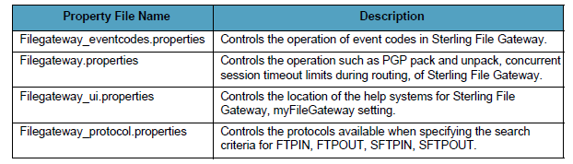
Property file
The property files help to customize, and diagnose problems pertaining to the operation of Sterling File Gateway. You can maintain customized property file settings with a customer override property file.
Property files are stored in <Install_dir>/properties folder. A few Sterling File Gateway property files are described in the table.
© Copyright IBM Corporation 2015

Slide 33
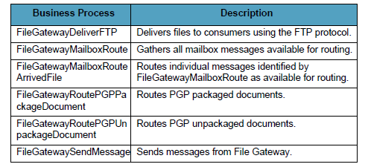
Business process
A business process is a series of linked software and possibly human activities that accomplishes a business goal. The activities in a business process are primarily performed by components known as services and adapters, and are orchestrated by Sterling B2B Integrator integration engine.
The following table provides the description of a few system business processes used for Sterling File Gateway operations:
© Copyright IBM Corporation 2015
Notes:
Note: Do not alter the system business processes. Sterling File Gateway business processes run in queues 3, 4, and 6. Do not change the queue settings of the system business processes because they are configured to optimize queue usage under heavy loads. Custom business processes (used for consumer identification or layer processing) should be configured to execute on any queue except 3 or 4.
© Copyright IBM Corporation 2015

Slide 34
Listening producer API
Listening producer allows Sterling File Gateway to access a user defined server and poll for documents to kick off Sterling File Gateway routes. The current functionality allows for initiating producers, which means you place a file into the producer’s mailbox in order to start the transaction.
The list of business processes in Sterling File Gateway 2.2.6.1 for listening producers, mass replay, FTP and SFTP are:
  FileGatewayListeningProducer
  FileGatewayListeningProducerFTP
  FileGatewayListeningProducerSFTP
  FileGatewayProcessFTPReply
  FileGatewayProcessReroute
© Copyright IBM Corporation 2015

Slide 35
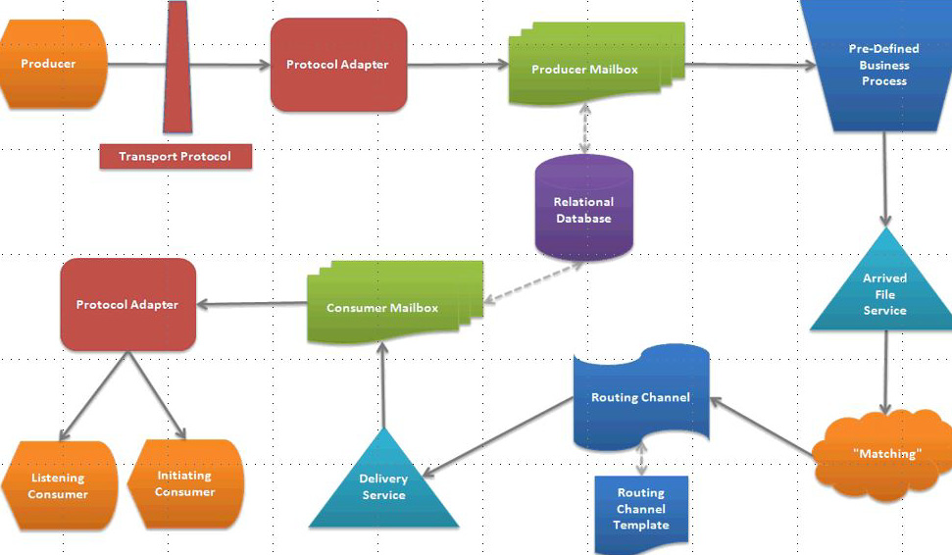
Sterling File Gateway process flow
© Copyright IBM Corporation 2015
Notes:
Following is a representation of the flow diagram during the file transfer communication:
1. The producer’s files is sent through the transport protocol.
2. The transport protocol invokes the appropriate protocol adapter and sends to the producer’s mailbox.
3. The system defined business process executes the files from the mailbox.
4. The business process invokes arrived file service, which checks the matching routing channel. The routing channel template verifies and, delivers the files.
5. The delivery service, delivers the documents to the consumer mailbox.
6. Consumer mailbox, in-turn, invokes the appropriate protocol adapter and initiates or listens to the document to further integrate into external system or process in Sterling B2B Integrator process.
© Copyright IBM Corporation 2015

Slide 36
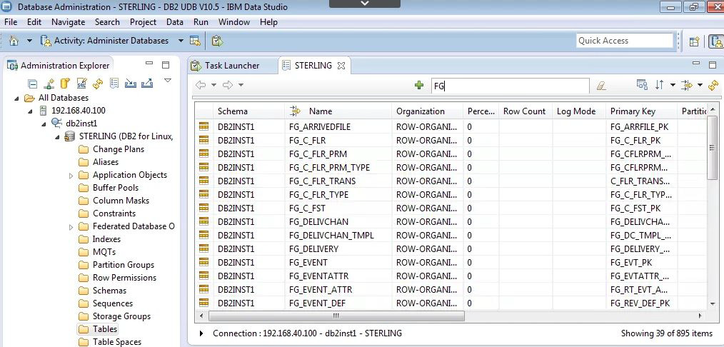
Database
There are around 89 built-in tables for Sterling File Gateway application in Sterling B2B Integrator suite.
© Copyright IBM Corporation 2015
Notes:
Complete the following steps to view the built-in tables of Sterling File Gateway:
From the window image, navigate to Start > All Programs > IBM Data Studio > Data Studio 4.1.0.0 Client.
Expand All Databases > 192.168.40.100 > Student1 > STERLING DB2 for Linux.
Click Tables to view list of tables.
Search tables specific to FG in the Search icon, as shown in the screen shot to view tables related to Sterling File Gateway.
© Copyright IBM Corporation 2015

Slide 37
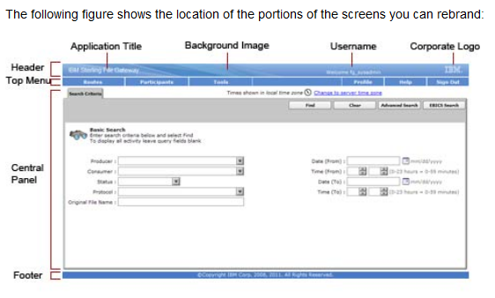
Rebranding
Sterling File Gateway interfaces can be customized to re-brand the product name, menus of Sterling File Gateway, and myFileGateway user interface to incorporate new company logo or other special content.
The screen shot represents a few standard names such as application title, background image, top menu, logo to customize the user interface of Sterling File Gateway.
Notes:
© Copyright IBM Corporation 2015

Slide 38
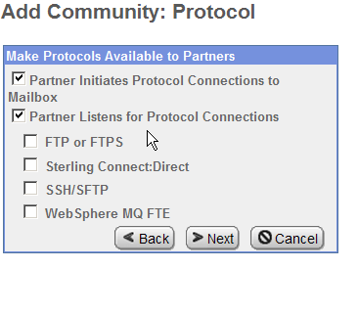
Custom Protocol
Sterling File Gateway supports to customize protocols for listening consumers.
The customizing protocol procedure determines the text that is shown in the Partner management wizard. Customized protocol, allows you to select, as new choices in the Sterling File Gateway interface:
  when creating a community.
  when creating a listening consumer in a community.

Slide 39
Creating Custom Protocol
To Add Custom Protocols
  1) Write a business process that implements the custom protocol.
  2) Use the existing AFTExtensions.xml as a guide to create an AFTExtensionsCustomer.xml file to describe the protocol which is present under - directory:<install_dir>\container\Applications\aft\WEB-INF\classes\resources\xml.
  3) Use the existing AFTExtensions.properties file as a guide to create the AFTExtensionsCustomer.properties file which is loacted under <install_dir>\container\Applications\aft\WEB-INF\classes\resources

Slide 40
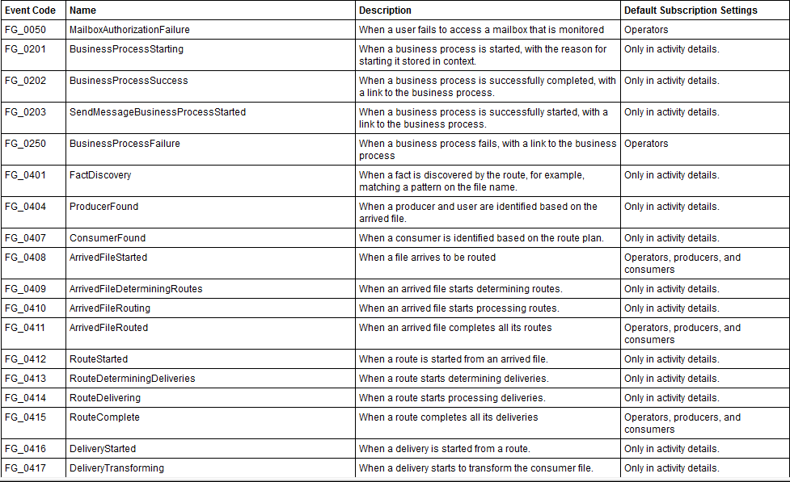
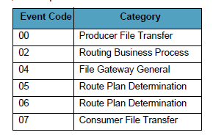
System event codes
Notes:
For more details, refer https://www.ibm.com/support/knowledgecenter/SS4TGX_2.2.0/com.ibm.help.sfg_sys_admin.doc/sfg_abouteventcodes.html?lang=en
© Copyright IBM Corporation 2015

Slide 41
Custom Event Codes
Each activity during the progress of a file transfer generates an event code. These codes are displayed in the activity details to enable Partners and Operators to see the progress and navigate to more details.
System Administrators can create custom event codes and modify the permissions for standard event codes.
Some event codes trigger notifications to subscribers. System Administrators can change the permissions for an event code by using the customer_overrides.properties file to override values in the filegateway_eventcodes.properties file.

Slide 42
Custom Event Codes
Event Code: The event code in the template you created is CUST_0265. It consists of keyword underscore 4-digit code. It is used to identify all the attributes for a particular event code.
Keyword - any text, optimally about four characters long, but cannot be FG nor AFT
4-digit Code - consists of two 2-digit codes - a category identifier and a unique identifier. No two events can have the same 4-digit code.
Category Identifier - The first 2- digit code is a category identifier.
Unique Identifier - The second 2-digit code is the unique identifier for the event within the category. 00 - 49 are successful events and 50 – 99 are error events. Error events show up as red in Sterling File Gateway.

Slide 43
Exercise
Graphic must not be moved, added to, or altered in any way.
Re-brand Sterling File Gateway.
Adding customer protocols.
Notes:
© Copyright IBM Corporation 2015

Slide 44
Completed lesson objectives
Describe the core Sterling File Gateway application files.
Explain the procedure to re-brand the user interface.
Describe the procedure to add custom protocols.
Explain the procedure to add custom event code.
© Copyright IBM Corporation 2015
Notes:
© Copyright IBM Corporation 2015

Slide 45
Questions
© Copyright IBM Corporation 2015
Notes:
© Copyright IBM Corporation 2015

Slide 46
Completed unit objectives
Explain the Sterling File Gateway dynamic route.
Discuss the Sterling File Gateway file layers.
Generate Sterling File Gateway reports.
Explain the extensibility of Sterling File Gateway.
© Copyright IBM Corporation 2015
Notes:
© Copyright IBM Corporation 2015

